Slide 1
Harvard style referencing training
Made by: Renáta herczeg

Slide 2
Plagiarism
- When the author of a thesis presents someone else’s work or ideas as his or her own, failing to use in-text references (therefore writing a bibliography only is not enough).
- Reference must also be made for verbatim citations and indirect references.
- Diagrams and images must also be referenced.
- Plagiarism checking (Moodle → BBU Repository of Degree Theses)

Slide 3
BBU FCHT Harvard system- Author-year method
Indirect reference:
The author's surname and the year of publication are placed in brackets after the referenced text.
Verbatim citation:
The author, year of publication and page number – where the quotation is taken from – are put in brackets at the end of the train of thought or paragraph cited in quotation marks. →Use verbatim citations only if necessary.
Personal leadership is important in achieving organizational goals (Sharplin, 1985).
“The importance of personal leadership in achieving organizational purposes is well established (Sharplin, 1985, p. 148).”

Slide 4
How to create in-text references?
- We include the name of the author in the text, followed by the year in brackets.
- In brackets, at the end of a train of thought or paragraph.
- In the case of a verbatim citation, the text is in quotation marks, with a reference at the end.
...personal leadership is emphasized by Sharplin (1985) in achieving organizational goals.
Personal leadership is important in achieving organizational goals (Sharplin, 1985).
“The importance of personal leadership in achieving organizational purposes is well established (Sharplin, 1985, p. 148).”

Slide 5
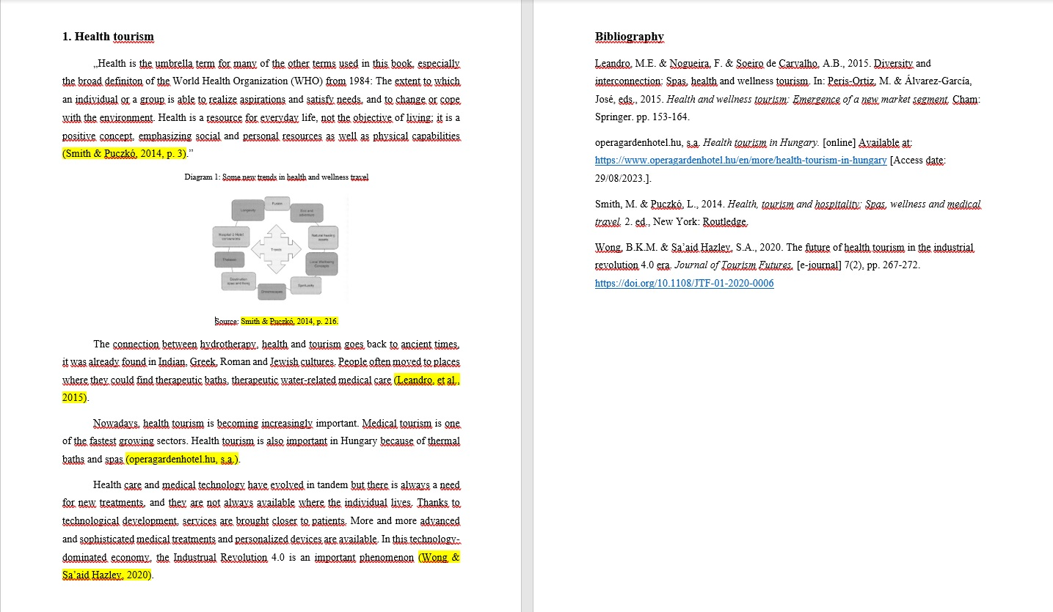

Slide 6
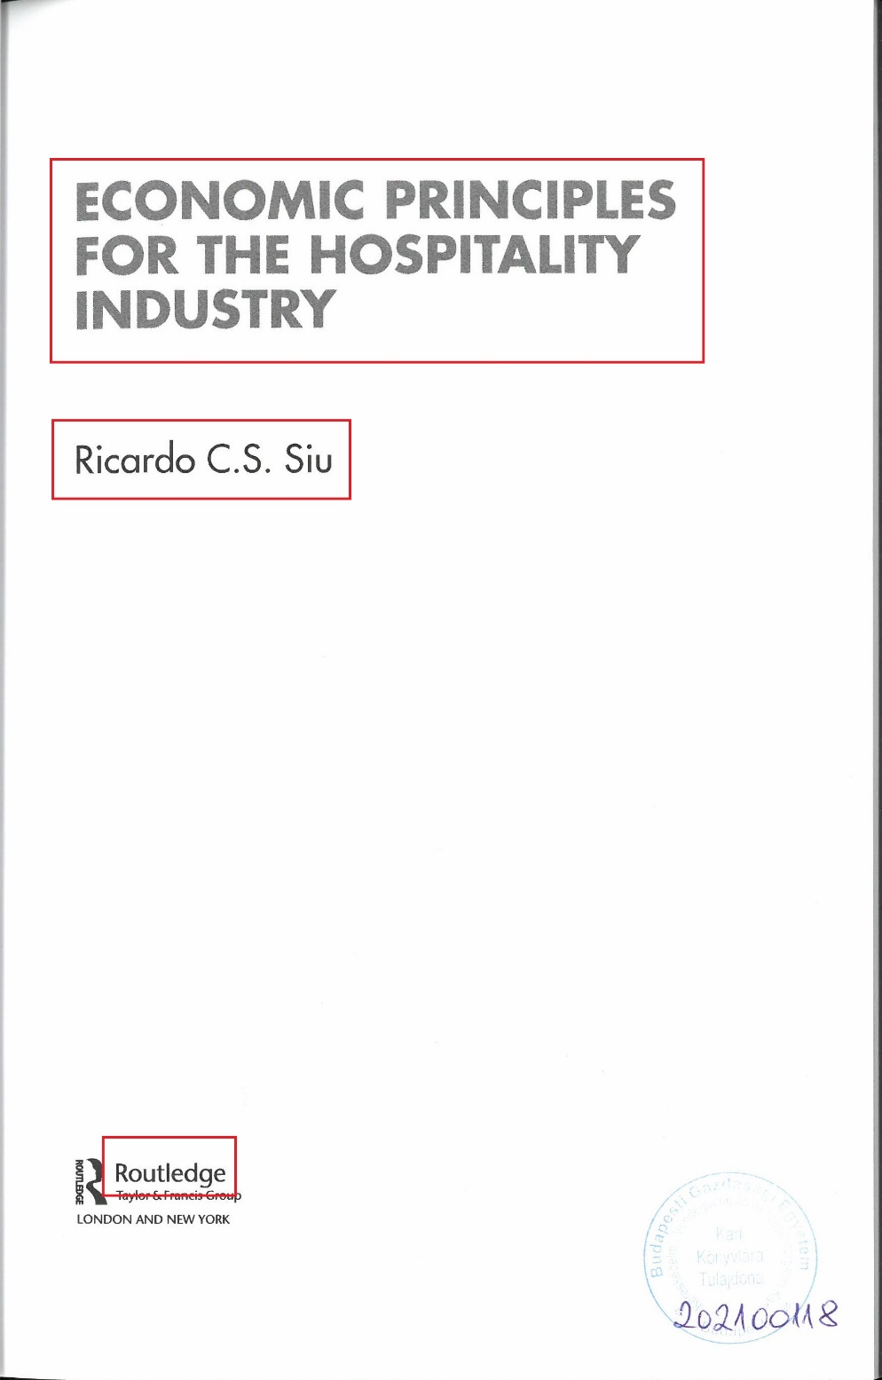
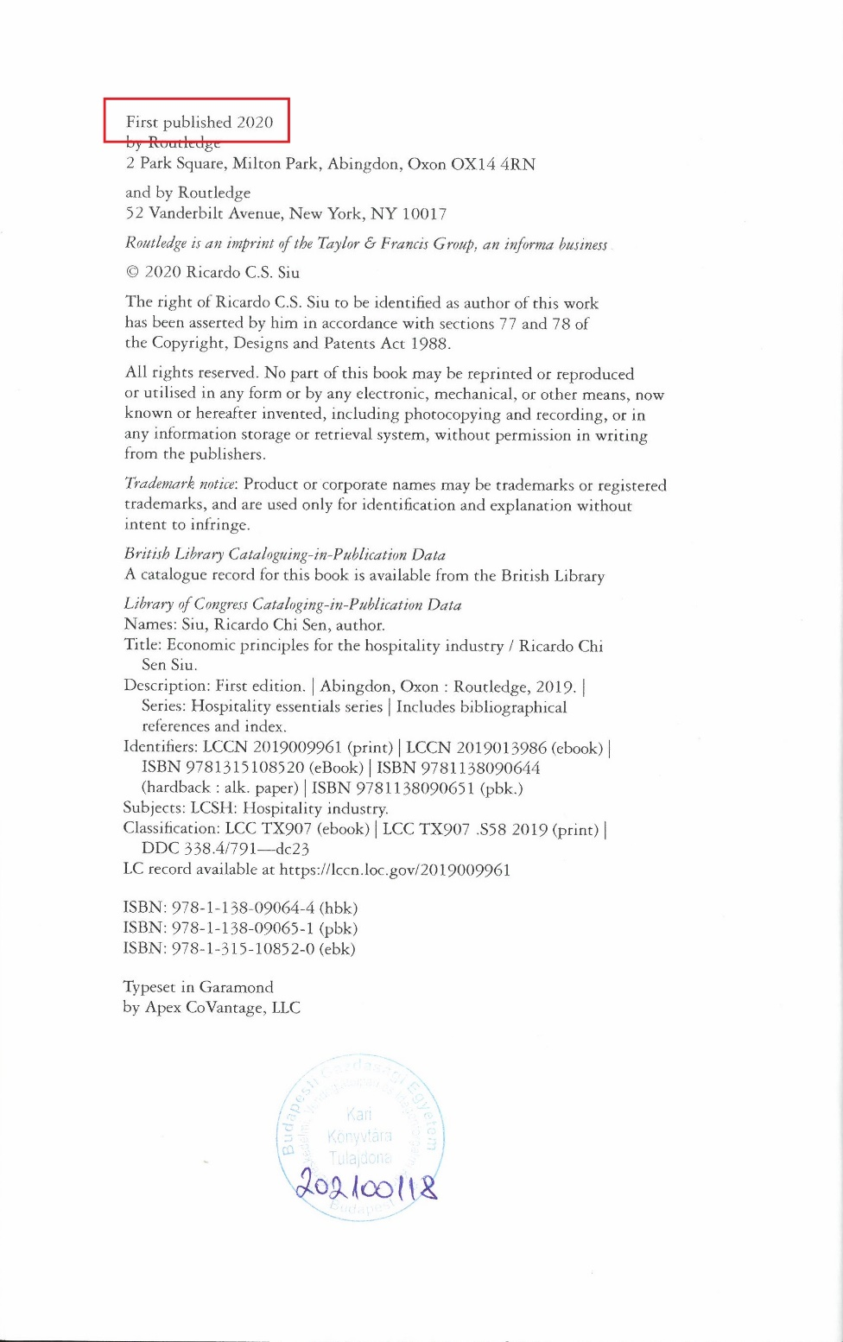
Book

Slide 7
Book
One author:
(Siu, 2020)
In the bibliography:
Siu, R.C.S., 2020. Economic principles for the hospitality industry. Abingdon: Routledge.
Two authors: (Reekie & Crook, 1995)
Three or more authors: (Clifton, et al., 1992)
If you are quoting several works written by the same author in the same year, they should be differentiated by adding a lower case letter (a, b, c, etc.) directly, with no space, after the year for each item:
(Thill & Bovée, 1996a)
(Thill & Bovée, 1996b)

Slide 8
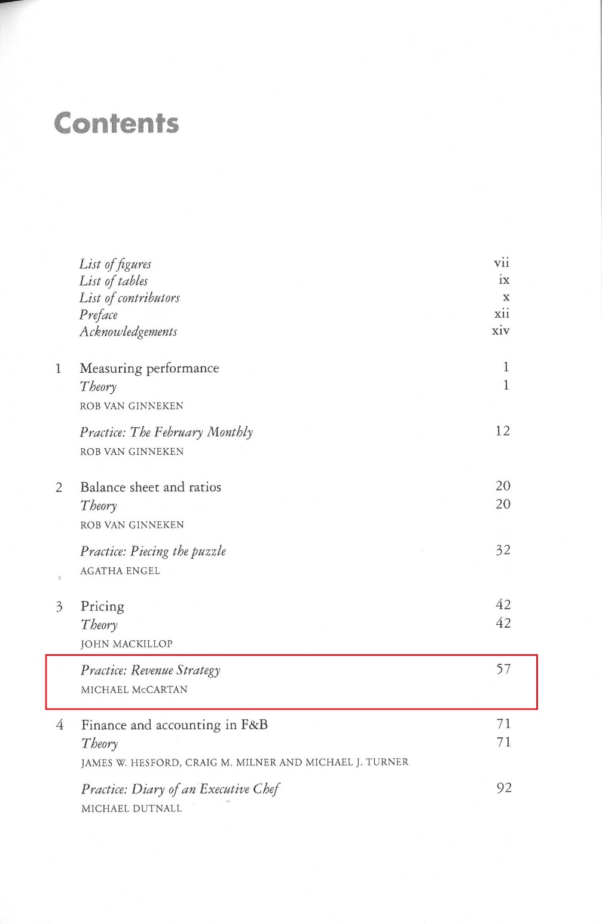
Book chapter

Slide 9
Book chapter
This is used for books, e.g. conference proceedings or collections of studies where each chapter is written by a different author and the book has an editor.
Refer to the author of the chapter and describe the book which contains the chapter in the bibliography. Page numbers of the chapter must also be indicated.
In-text reference:
(McCartan, 2019)
In the bibliography:
McCartan, M., 2019. Practice: Revenue strategy. In: Ginneken, R., ed., 2019. Hospitality finance and accounting: Essential theory and practice. Abingdon: Routledge. pp. 57-70.
Chapter details
In which book was it published
Starting and closing page numbers

Slide 10
Article

Slide 11
Article
If no author is specified for the newspaper article, the title of the journal can be given instead of the author.
(Example: The Economist, 2021)
In-text reference:
(Sahin, et al., 2020)
In the bibliography:
Sahin, S. & Baloglu, S. & Topcuoglu, E., 2020. The Influence of Green Message Types on Advertising Effectiveness for Luxury and Budget Hotel Segments. Cornell Hospitality Quarterly, 61(4), pp. 443-460.
In the case of articles, you must indicate the starting and closing page number in the bibliography. It shows which pages of the journal the article is on.
Volume
Issue

Slide 12
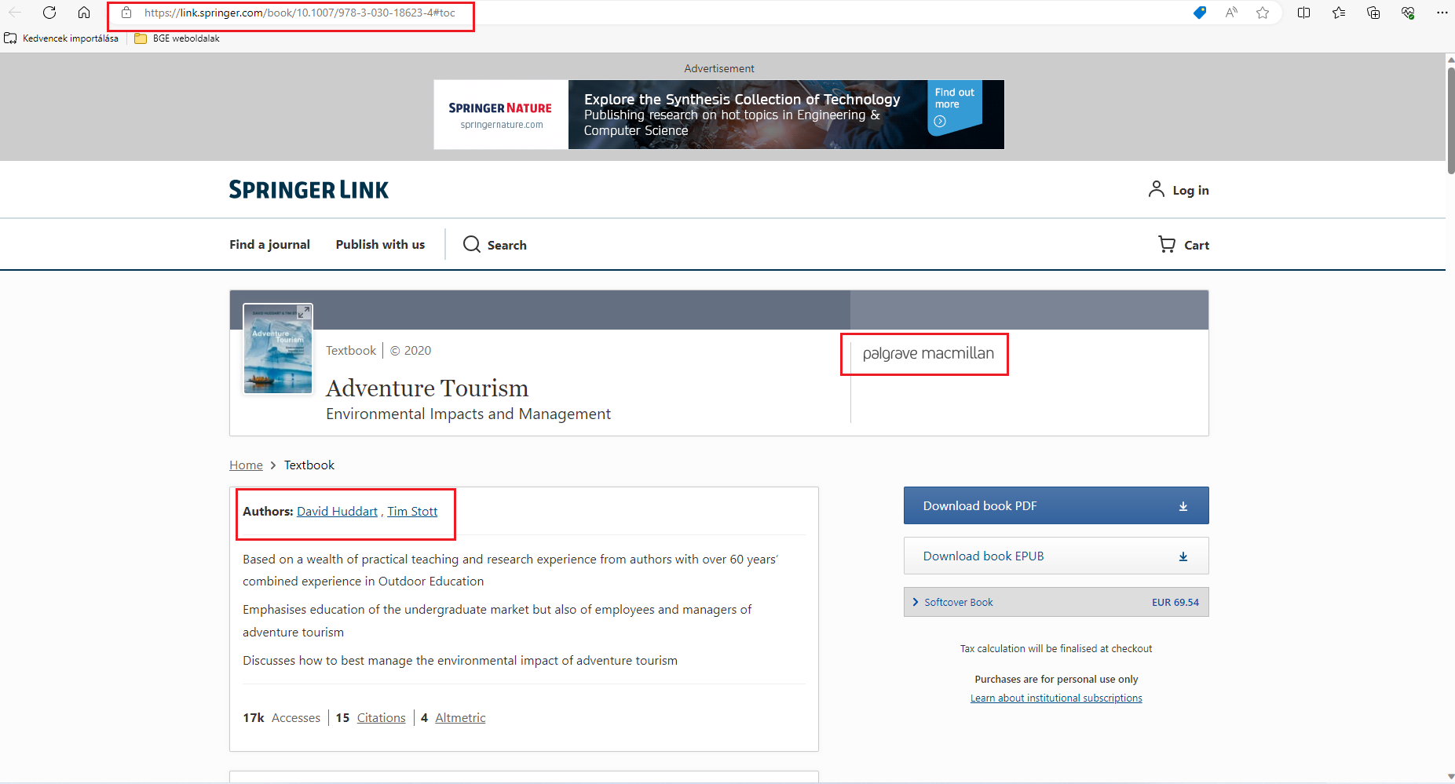
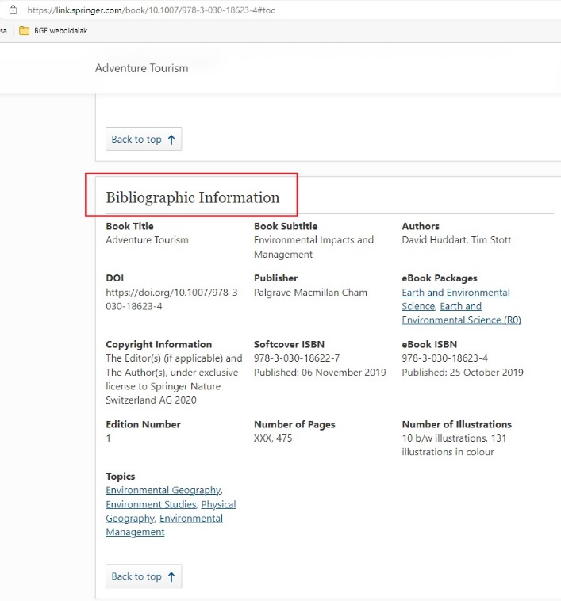
Electronic reference
E-book

Slide 13
Electronic reference
E-book
Add the URL and the access date to the reference format of the printed book.
In-text reference:
(Huddart & Stott, 2020)
In the bibliography:
Huddart, D. & Stott, T., 2020. Adventure Tourism. [e-book] Liverpool: Palgrave Macmillan. Available at: https://link.springer.com/book/10.1007/978-3-030-18623-4#toc [Access date: 16/03/2021.].

Slide 14
Electronic reference
DOI number
Article

Slide 15
Electronic reference
Article
Add the URL and the access date (or the DOI number can be used instead of these two) to the reference format of the printed article.
In-text reference: (Agarwal, et al., 2022)
In the bibliography:
Agarwal, V. & Koch, J.V. & McNab, R.M., 2022. Airbnb’s Success: Does It Depend on Who Is Measuring? Cornell Hospitality Quarterly, [e-journal] 63(4), pp. 519-527. Available at: https://journals.sagepub.com/doi/epdf/10.1177/19389655211029914 [Access date: 10/03/2023.].
Agarwal, V. & Koch, J.V. & McNab, R.M., 2022. Airbnb’s Success: Does It Depend on Who Is Measuring? Cornell Hospitality Quarterly, [e-journal] 63(4), pp. 519-527. https://doi.org/10.1177/19389655211029914
With DOI number:

Slide 16
Website
- If you can't find an author, use the name of the website as a reference, and if there is an author, always refer to his name just like in the case of a book or an article.
In-text reference: (london.gov.uk, 2021)
(Kalmár, 2023)
Irodalomjegyzékben:
london.gov.uk, 2021. Supporting the Tourism sector. [online] Available at: https://www.london.gov.uk/what-we-do/business-and-economy/supporting-londonssectors/supporting-tourism-sector [Access date: 16/03/2021.].
Kalmár, B., 2023. 4+1 bormarketingstratégia, hogy több bor fogyjon. [online] Available at: https://vince.hu/szakma/bormarketing-strategia/ [Access date: 24/02/2023.]. Based on own translation.

Slide 17
Interview
- It is important to check with the person being interviewed that they are in agreement with a transcript of the interview being made available.
- If you include the fact, time and interviewee of the interview in the text, then it is not necessary to refer to it separately in the text, but you will still need to put the item in the bibliography.
- The transcript of the interview should be included in the Appendix of the thesis.
- Refer to the interviewee's name, not your own.
In-text reference: (Lindsay, 2017) (see Appendix 1 for the interview
abstract)
In the bibliography:
Lindsay, I., 2017. Interview with Iain Lindsay, British Ambassador to Hungary. Interviewer: Máté Kovács. [interview] Budapest, 1 February.

Slide 18
Missing details
No author:
- When the authorship is unknown: (Anonymous, 2020) ; (Anon., 2020)
- If the author cannot, but the corporate authorship (corporation, foundation, institution) can be identified, it should be used instead: (Hungarian Chamber of Commerce and Industry, 2018) ; (Hungarian Central Statistical Office, 2021)
- For journal articles with no author name indicated, or with initials or a pseudonym, the title of the journal must be referenced: (Cornell Hospitality Quarterly, 2018)
No date: s.a. (Smith, s.a.)
No place of publication: s.l.
No publisher: s.n.
No page number: s.p.

Slide 19
Secondary reference
- You may come across a summary or quotation of another author’s work in the source you are reading, which you would like to cite in your own piece of work, this is called secondary referencing.
- If possible, retrace the original source and refer to it instead.
In-text reference:
(Baines, 1834, cited in Seaton & Bennett, 1996)
In the bibliography:
Seaton, A. V. & Bennett, M. M., 1996. The marketing of tourism products: concepts, issues and cases. London: ITP.

Slide 20
Additional options
- If a train of thought/paragraph is developed using the works of multiple authors, and you do not specifically indicate which statement comes from which author, you should list the sources in an in-text reference by authors in brackets in alphabetical order, separated by semicolons at the end of the train of thought/paragraph:
Example:
In-text reference: (Bennett, 1999; Siu, 2000)
In the bibliography:
Bennett, R., 1999. International business. 2. ed., Harlow: Prentice Hall.
Siu, R.C.S., 2020. Economic principles for the hospitality industry. Abingdon: Routledge.
- If you’re writing more than one paragraph from a work, but that section can be clearly separated, then it is possible to refer only once, after the last paragraph, but this should not be more than one page. There should be at least one reference on each page, but it is best to have it after each paragraph, even if you refer to the same source.

Slide 21
Bibliography
- In alphabetical order
- Authors' surnames are followed by the initials of their first names.
Agarwal, V. & Koch, J.V. & McNab, R.M., 2022. Airbnb’s Success: Does It Depend on Who Is Measuring? Cornell Hospitality Quarterly, [e-folyóirat] 63(4), pp. 519-527. https://doi.org/10.1177/19389655211029914
Bennett, R., 1999. International business. 2. ed., Harlow: Prentice Hall.
Huddart, D. & Stott, T., 2020. Adventure Tourism. [e-book] Liverpool: Palgrave Macmillan. Available at: https://link.springer.com/book/10.1007/978-3-030-18623-4#toc [Access date: 16/03/2021.].
Kalmár, B., 2023. 4+1 bormarketingstratégia, hogy több bor fogyjon. [online] Available at: https://vince.hu/szakma/bormarketing-strategia/ [Access date: 24/02/2023.]. Based on own translation.
Lindsay, I., 2017. Interview with Iain Lindsay, British Ambassador to Hungary. Interviewer: Máté Kovács. [interview] Budapest, 1 February.
london.gov.uk, 2021. Supporting the Tourism sector. [online] Available at: https://www.london.gov.uk/what-we-do/business-and-economy/supporting-londonssectors/supporting-tourism-sector [Access date: 16/03/2021.].
McCartan, M., 2019. Practice: Revenue strategy. In: Ginneken, R., ed., 2019. Hospitality finance and accounting: Essential theory and practice. Abingdon: Routledge. pp. 57-70.
Sahin, S. & Baloglu, S. & Topcuoglu, E., 2020. The Influence of Green Message Types on Advertising Effectiveness for Luxury and Budget Hotel Segments. Cornell Hospitality Quarterly, 61(4), pp. 443-460.
Siu, R.C.S., 2020. Economic principles for the hospitality industry. Abingdon: Routledge.

Slide 22
Plagiarism checking
- If you create references correctly, you will not commit plagiarism.
- The plagiarism checker software does not check the references, but looks for matching passages and gives a percentage result. Discuss the result with your consultant.
- You have to upload your thesis to the Moodle e-learning interface. Plagiarism is also filtered on this interface, and later (after thesis defense) the uploaded theses are automatically transferred to the BBU Repository, where the long-term storage and research service takes place.
- Guide to uploading thesis to Moodle: https://konyvtar-kvik.uni-bge.hu/wp-content/uploads/2024/03/Thesis_upload_guide_2023_24_2.pdf

Slide 23
Guides, summaries
Complete guide to Harvard style referencing (with many more document types): https://konyvtar-kvik.uni-bge.hu/wp-content/uploads/2024/04/Hivatkozas-guide_en-2024-2.0.pdf
Summary table for Harvard style referencing: https://konyvtar-kvik.uni-bge.hu/wp-content/uploads/2024/02/Quick-guide-to-Harvard-referencing_2024.pdf
Thesis writing guide: https://konyvtar-kvik.uni-bge.hu/wp-content/uploads/2024/02/Thesis-writing-guide-for-undergraduate-BSc-and-graduate-MSc-students.pdf
Declaration of originality can be downloaded from here: https://konyvtar-kvik.uni-bge.hu/en/szakdolgozat-thesis/
Request for support:
BBU FCHT Faculty Library konyvtar.kvik@uni-bge.hu
BBU FCHT Tourism Library idfokonyvtar@uni-bge.hu

Slide 24
Thank you for your attention.

