Slide 1
Subscribed databases

Slide 2
What is an electronic database?
an online collection of downloadable resources with multiple search options
Which English text databases is the University subscribed to?
Scientific/academic contents
Full texts
Academic Publishing House, Emerald, Interkönyv, L’Harmattan Open Access, Kossuth Kiadó, HCSO (free), MERSZ, SpringerLink, Szaktárs, UNWTO
Indexes, abstracts and citations
Scopus, Web of Science
According to document type
Journals, articles, e-books, book chapters, case studies, market analyses, statistics
According to access type
Open Access content – available for all internet users
Subscribed content – available for subscribing institutions
Fee-paying content – available after paying individually

Slide 3
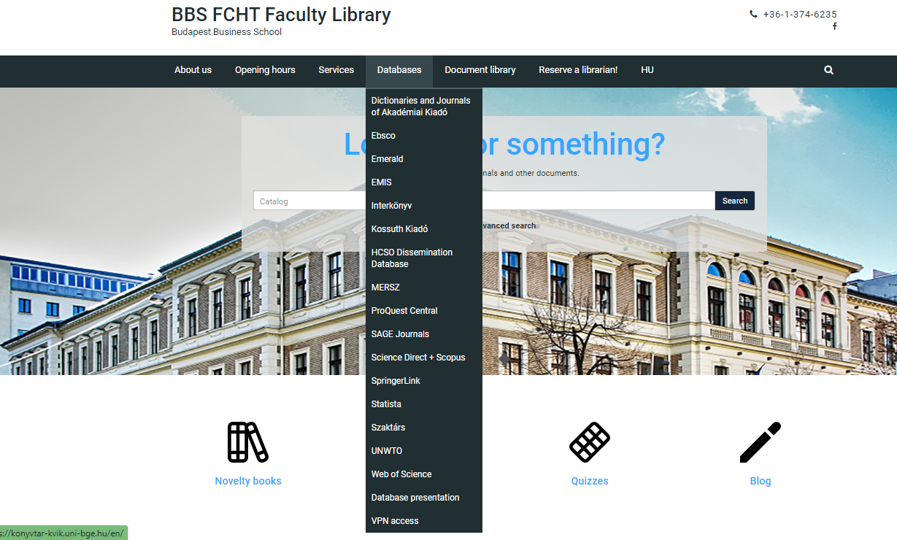
You can find them on the Library’s website
http://konyvtar-kvik.uni-bge.hu/
Click on the name of a database, read the information, and enter the database.

Slide 4
VPN (Virtual Private Network) access
http://konyvtar-kvik.uni-bge.hu/
You can ask for VPN remote access to the databases on your computer by following the information.

Slide 5
Journal database
AK Journals: https://akjournals.com
Hungarian authors’ peer reviewed articles

Slide 6
E-book and journal database
Emerald: http://emeraldinsight.com Main fields of science: Marketing, management, business sciences, tourism, hospitality
SpringerLink: http://link.springer.com Academic journals, handbooks, conference presentations, monographs, protocols and more

Slide 7
How to search in Emerald?
Advanced search

Slide 8
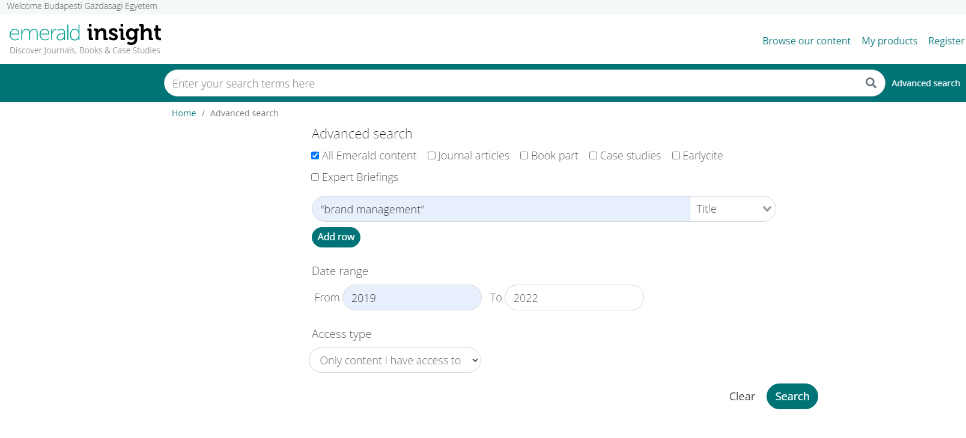
Advanced search

Slide 9
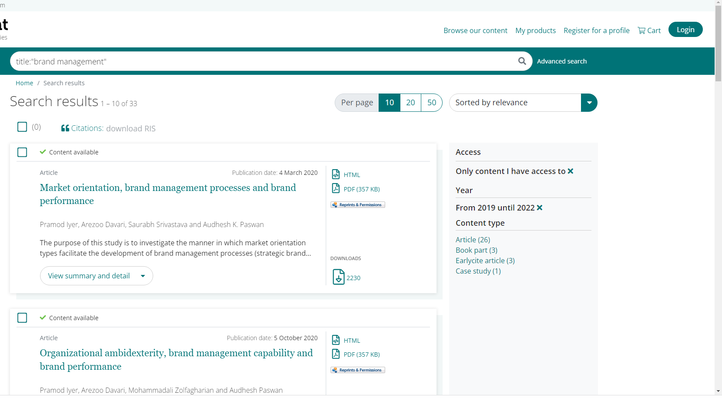
Result list

Slide 10
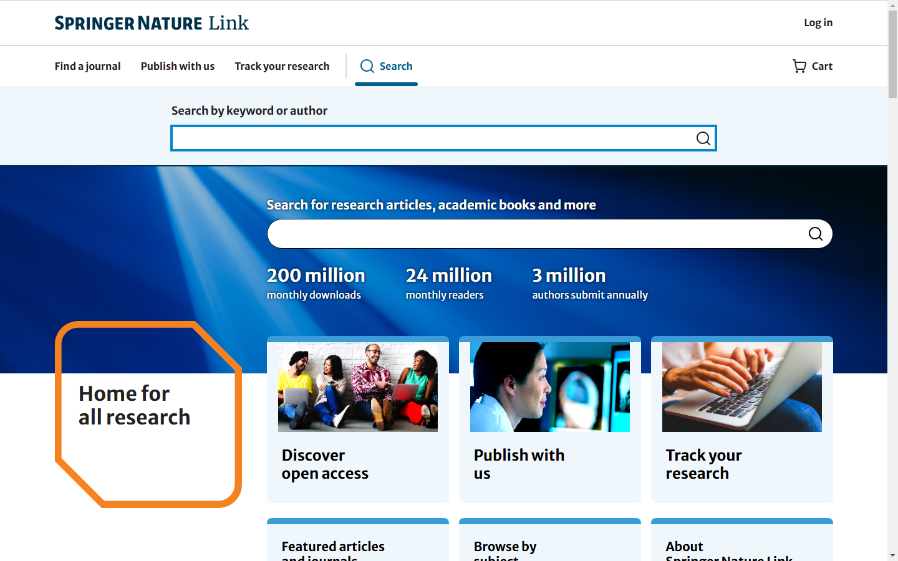
How to search in SpringerLink?

Slide 11
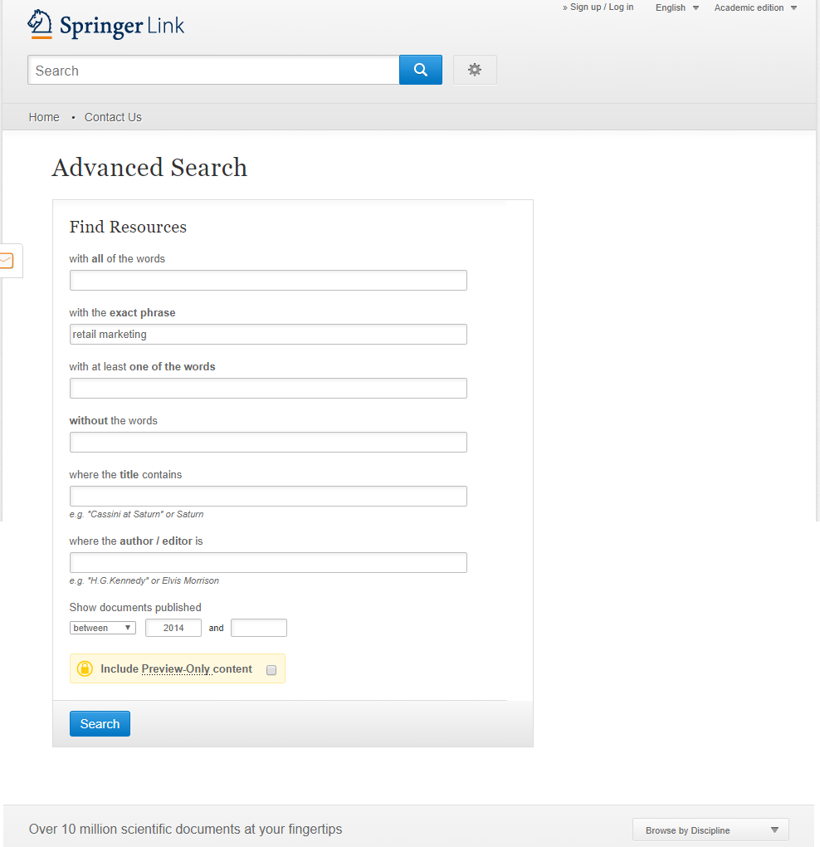
Advanced search
Search for exact phrase
Search in title
Search for author
Search only in subscribed contents

Slide 12
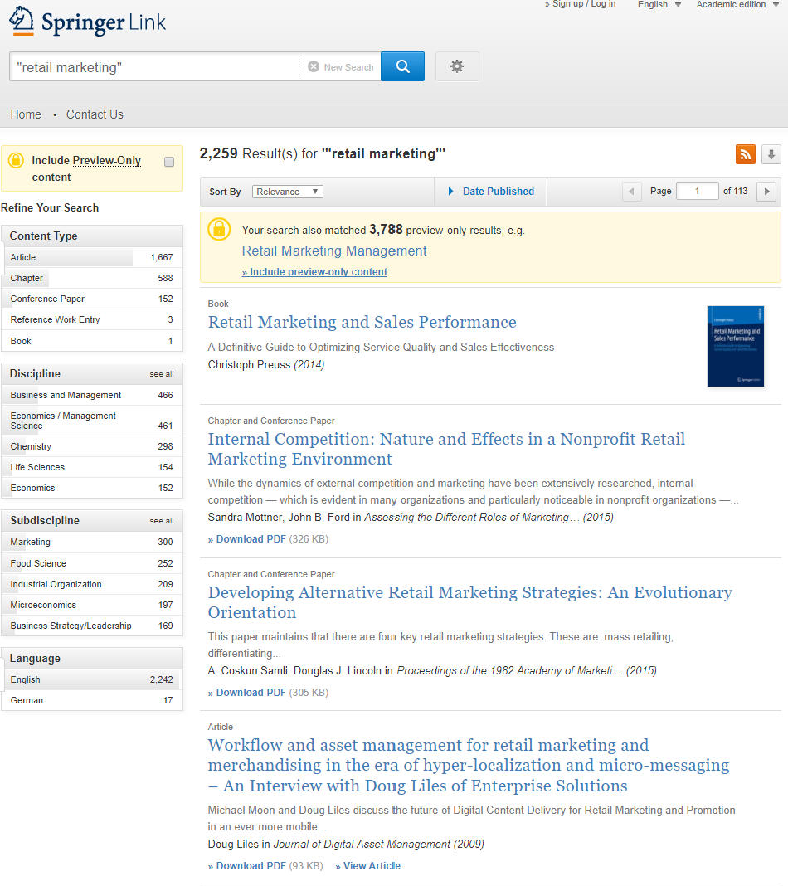
Result list
E-book: download by chapters
Download result list
Download in PDF
Additional filtering options

Slide 13
Special databases
KSH (HCSO): ksh.hu/?lang=en
The database of Hungarian Central Statistical Office provides statistical data and data analyses on Hungary. In the Disseminator database you can get statistical data by subjects.
UNWTO: e-unwto.org
An online service of the United Nations World Tourism Organization that provides statistics and e-books on tourism.

Slide 14
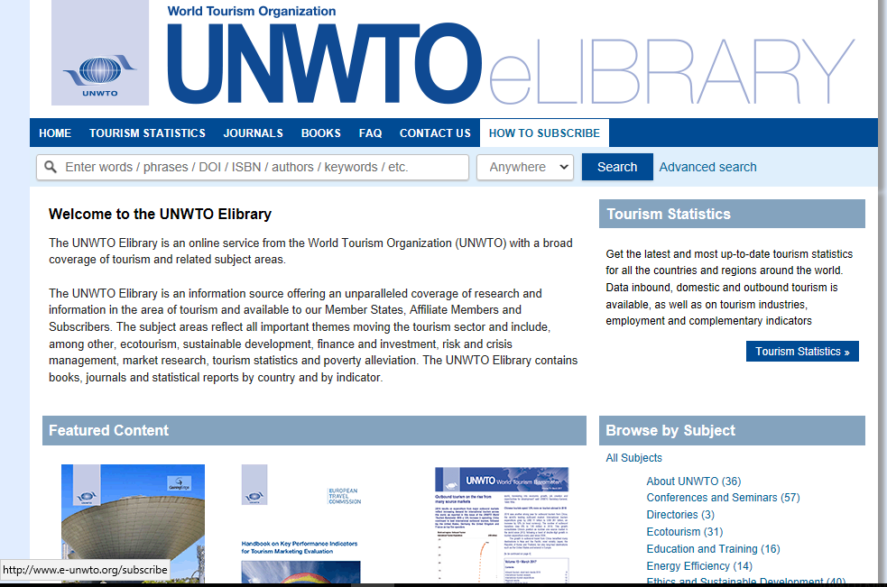
UNWTO Elibrary
http://www.e-unwto.org/
Online service of the United Nation World Tourism Organization
Statistics and e-books

Slide 15
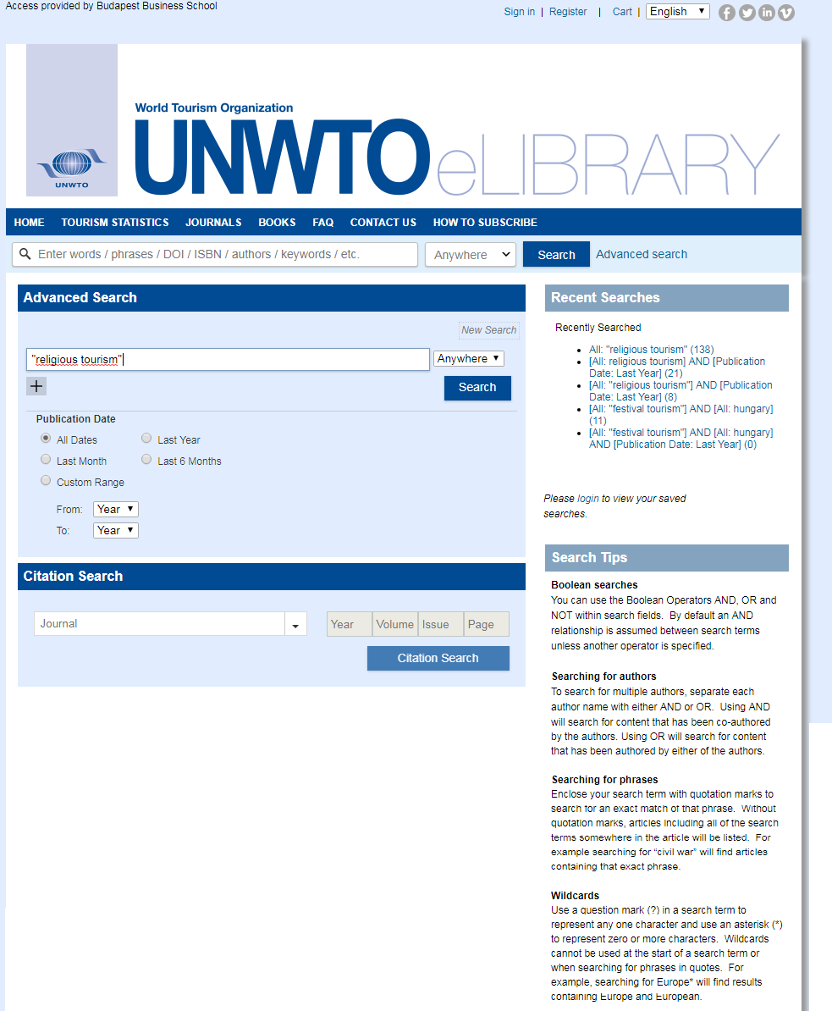
Advanced search

Slide 16
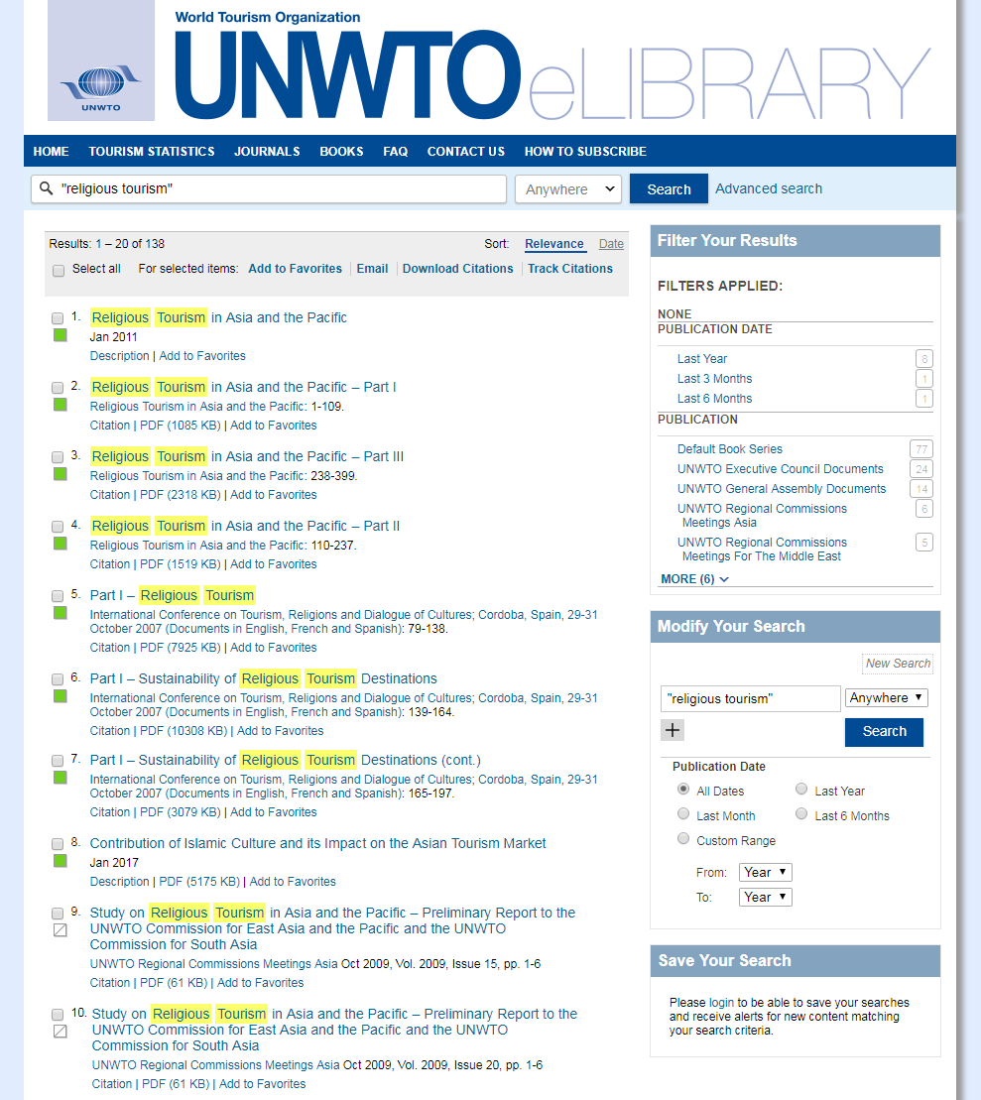
Result list of advanced search
Additional filtering options
Download in PDF
No access to this content

Slide 17
Thank you for your attention!

